Slide 1
PRODUCT ANALYSIS USING A PRIORI/ASSOCIATION RULES WELCOME
I.keerthika | S.Nivethitha | T.Vinothini,
Third Year B.SC.CS(DS&A),
Department of Data Science & Analytics,
Nadar Mahajana Sangam S.Vellaichamy Nadar College,
Nagamalai ,Madurai-625019
Under the guidence of
Dr.A.Sharmista
Head & Assistant Professor
This Photo by Unknown Author is licensed under CC BY

Slide 2
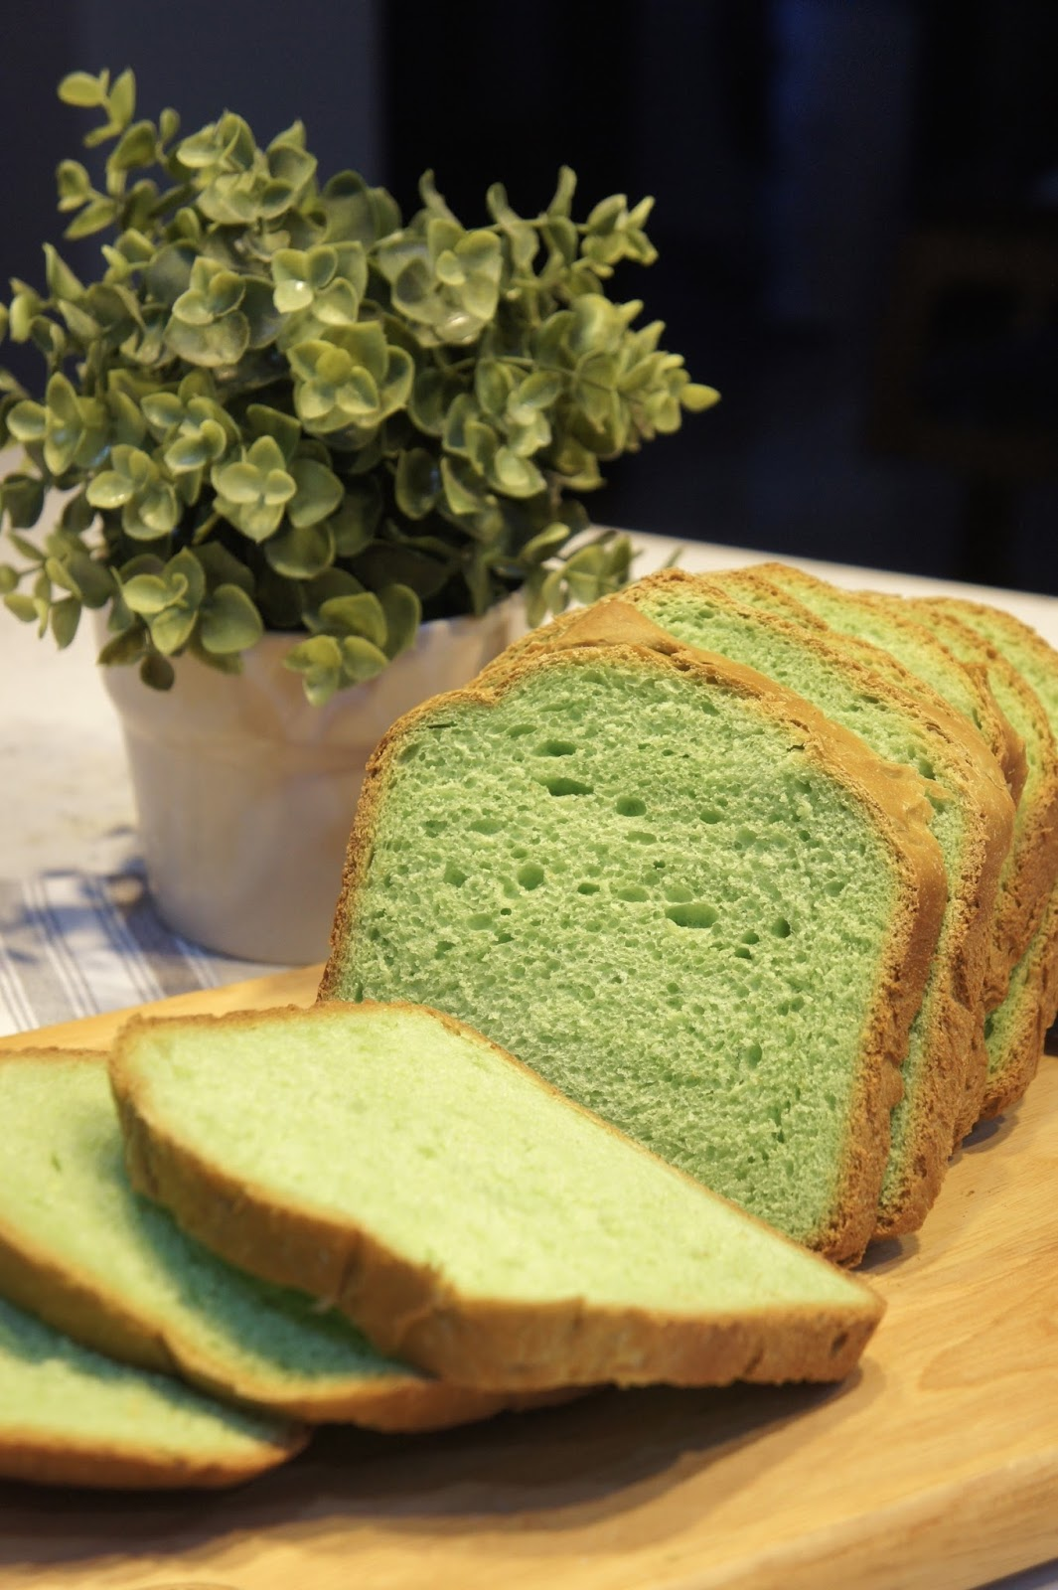

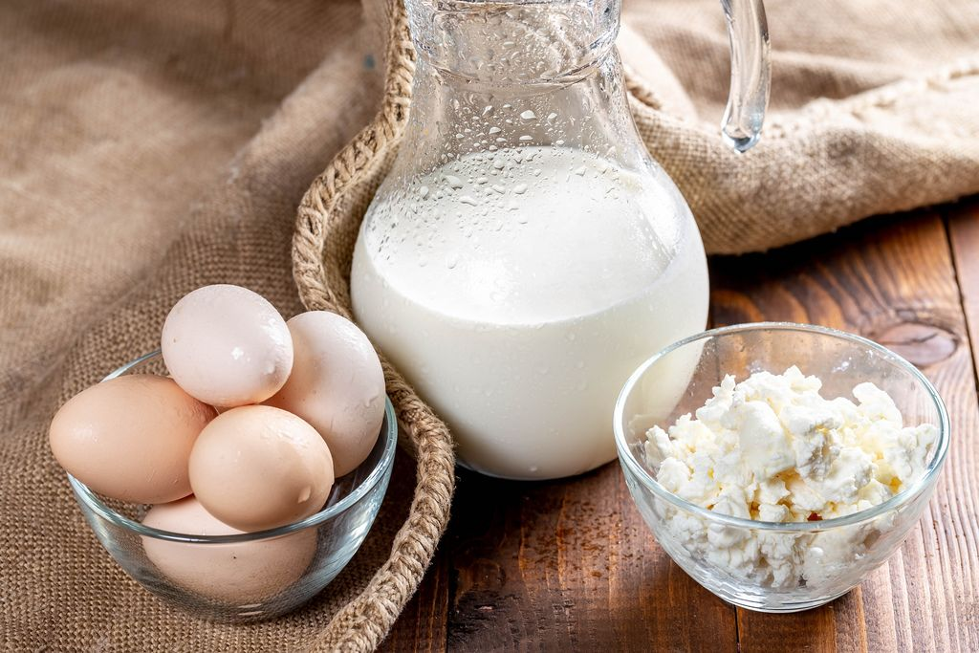

Frequent Itemsets Example:

Slide 3
INTRODUCTION
Understanding customer buying behavior is key in retail. This study uses the Apriori algorithm, a market basket analysis tool, to identify frequent product pairings from transaction data. The insights help improve product placement, promotions, and inventory strategies for better sales and customer experience.

Slide 4
OBJECTIVE OF THE STUDY
Analyze customer transactions to identify buying patterns.
Use the Apriori algorithm to find frequent item combinations.
Generate association rules for related products.
Support retail strategies like shelf layout and promotions.
Assess the usefulness of market basket analysis in retail decision-making.

Slide 5
LITERATURE REVIEW
Association rule mining, especially the Apriori algorithm by Agrawal and Srikant (1994), is widely used to find frequent itemsets and product associations in retail data. Studies show its effectiveness in improving product placement and promotions. Though Apriori can be slow with large datasets, it remains popular for its simplicity and usefulness in understanding customer buying behavior.

Slide 6
METHODOLOGY
Data Collection – Retail transaction records are gathered from real or public datasets, each showing items bought together.
Data Preparation – Data is cleaned and transformed (e.g., into a binary matrix) to ensure it's suitable for analysis.
Execution of Apriori Algorithm – The Apriori algorithm is applied with defined minimum support and confidence to find frequent itemsets.
Deriving Association Rules – Strong product relationships are identified using support, confidence, and lift metrics.
Analysis and Interpretation – The rules are analyzed for practical retail use, focusing on those with high confidence and lift.
Tools and Environment – Analysis is done using tools like Python (with mlxtend, pandas), R, or Weka, depending on dataset needs.

Slide 7
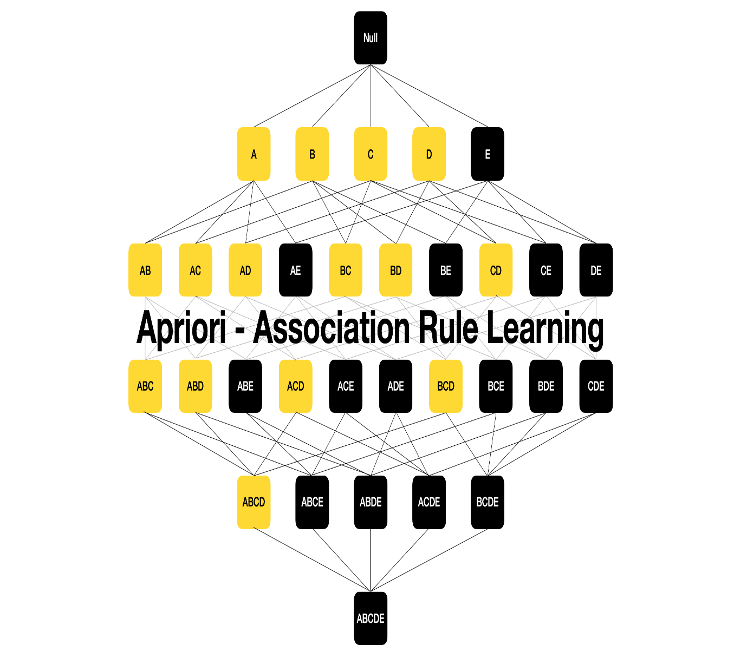
Graphical Representation of Frequent Itemset Generation in Apriori Algorithm

Slide 8
IMPLEMENTATION
Data Preparation: Transaction data was converted into a binary matrix, where each item was marked as 1 (present) or 0 (absent) in each transaction.
Parameter Configuration: Minimum support was set at 2%, and minimum confidence at 50% to filter significant itemsets and rules.
Frequent Itemsets Identification: The Apriori algorithm was applied to discover itemsets that met the support threshold.
Association Rule Extraction: Association rules were generated from the frequent itemsets and evaluated using support, confidence, and lift to determine their strength and relevance.

Slide 9
RESULTS
The Apriori analysis revealed strong product associations:
Bread → Butter: Support 3.5%, Confidence 65%, Lift 1.4
Milk → Diapers: Support 2.8%, Confidence 60%, Lift 1.3
Eggs → Bacon: Support 2.1%, Confidence 55%, Lift 1.5
These associations suggest frequent co-purchases, indicating cross-selling opportunities and insights for better product placement. The lift values above 1 confirm that these item pairings occur more often than by chance.

Slide 10
EXPERIMENTAL ANALYSIS
RULE ID | ASSOCIATION RULE | SUPPORT | CONFIDENCE(%) | LIFT
R1 | Customers buying milk also tend to buy Bread | 25% | 60% | 1.50%
R2 | Those who purchase both Diapers and Milk are likely to buy Beer | 15% | 70% | 1.75
R3 | Bread and Butter often lead to Jam purchases | 10% | 65% | 1.80
R4 | Egg buyers frequently include Salt in their carts | 20% | 55% | 1.20
R5 | Tea purchases are commonly paired with Sugar | 30% | 75% | 2.00

Slide 11
PRODUCT ANALYSIS
graphical representation for product Analysis using A Priori/Association Rules

Slide 12
DISCUSSION
The Apriori algorithm effectively identified frequent product pairings, offering insights to enhance store layout, promotions, and inventory management. Its success depends on proper support and confidence thresholds, though it may struggle with large datasets. Despite limitations, Apriori remains a useful tool in retail analytics, with future work aiming at scalability and improved evaluation metrics.

Slide 13
CONCLUSION
This study demonstrates that the Apriori algorithm effectively uncovers product associations in sales data, offering insights into customer behavior. These insights can help retailers optimize layouts, promotions, and inventory. While challenges like threshold selection and data size remain, Apriori remains valuable. Future research should explore more efficient algorithms and evaluation methods to enhance scalability and business impact.

Slide 14
REFERENCE
Agrawal & Srikant (1994) Introduced the Apriori algorithm for mining frequent itemsets and association rules using a bottom-up approach with pruning.
Han, Pei & Yin (2000) Proposed the FP-Growth algorithm, which uses an FP-tree to efficiently mine frequent patterns without candidate generation.
Tan, Steinbach & Kumar (2018) A key textbook that explains core data mining techniques like classification, clustering, and association analysis with both theory and application.

Slide 15
Thank you

